Slide 1
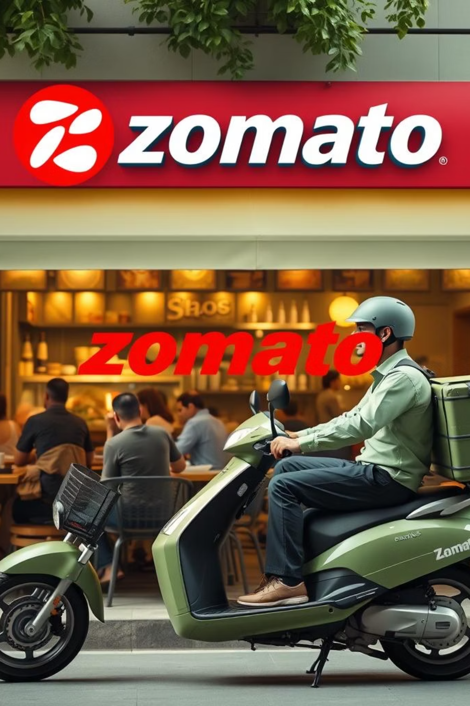
Unlocking Restaurant Success: A Data-Driven Approach
This presentation explores how data science can transform the restaurant industry, focusing on predicting restaurant ratings and identifying strategic locations for new establishments in Bengaluru. We'll delve into key factors influencing success and demonstrate the power of data analysis in this dynamic sector.

Slide 2
Agenda
01
02
03
The Challenge & Opportunity
Data Preparation
Cuisine & Dish Popularity
Understanding the competitive landscape and the potential of data in Bengaluru's vibrant food scene.
Cleaning and transforming raw Zomato data for robust analysis.
Identifying customer favourites and common menu items across restaurants.
04
05
06
Geographic Distribution
Impact of Facilities
Customer Rating Insights
Analysing restaurant density and market saturation in different Bengaluru localities.
Examining how online ordering and table booking influence customer ratings.
Understanding the distribution of aggregate ratings and customer sentiment.
07
Strategic Locational Insights
Leveraging data to inform decisions for new restaurant ventures.

Slide 3
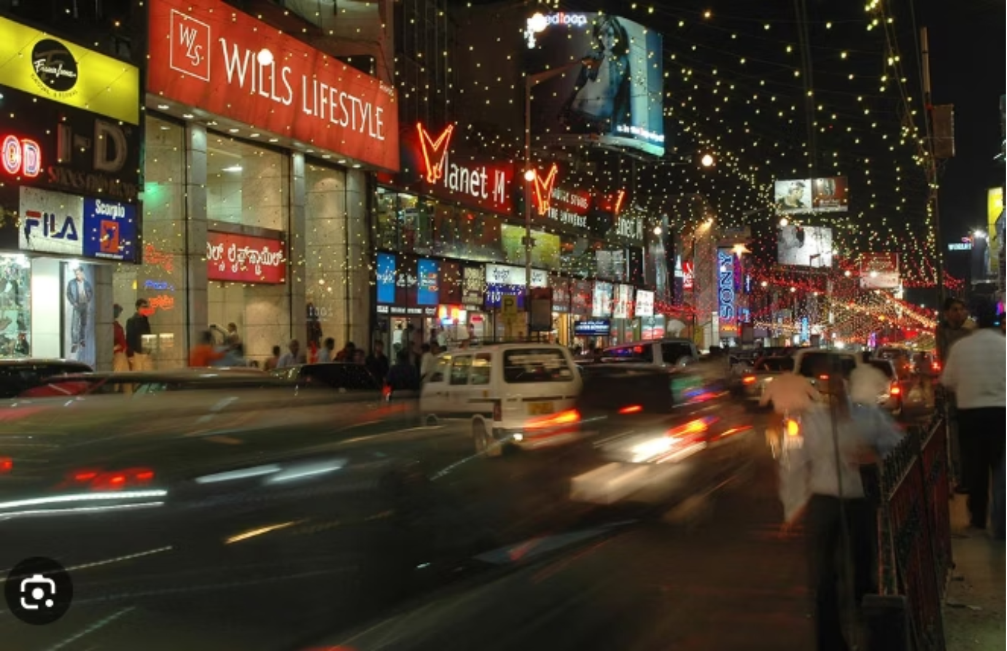
The Challenge and Opportunity in Bengaluru's Restaurant Scene
Bengaluru's restaurant industry is booming, with over 12,000 establishments offering diverse cuisines. This high demand fuels continuous growth, yet new entrants face significant challenges competing with established brands.
Our objective as data scientists is to harness the power of data to predict restaurant success factors, enabling new ventures to thrive and helping customers discover the best dining experiences.

Slide 4




Data Preparation: Laying the Foundation for Insights
Before diving into analysis, rigorous data cleaning and transformation are essential. This ensures the accuracy and reliability of our findings, forming a solid basis for predictive modeling.
Raw Data Collection
Data Type Conversion
Gathering comprehensive Zomato dataset, including ratings, costs, and restaurant attributes.
Converting 'rate' and 'cost for two plates' columns to appropriate numerical formats for analysis.
Rating Normalisation
Validation & Verification
Extracting numerical rating values by removing the '/5' suffix for consistent data.
Ensuring data integrity and readiness for machine learning model training.

Slide 5
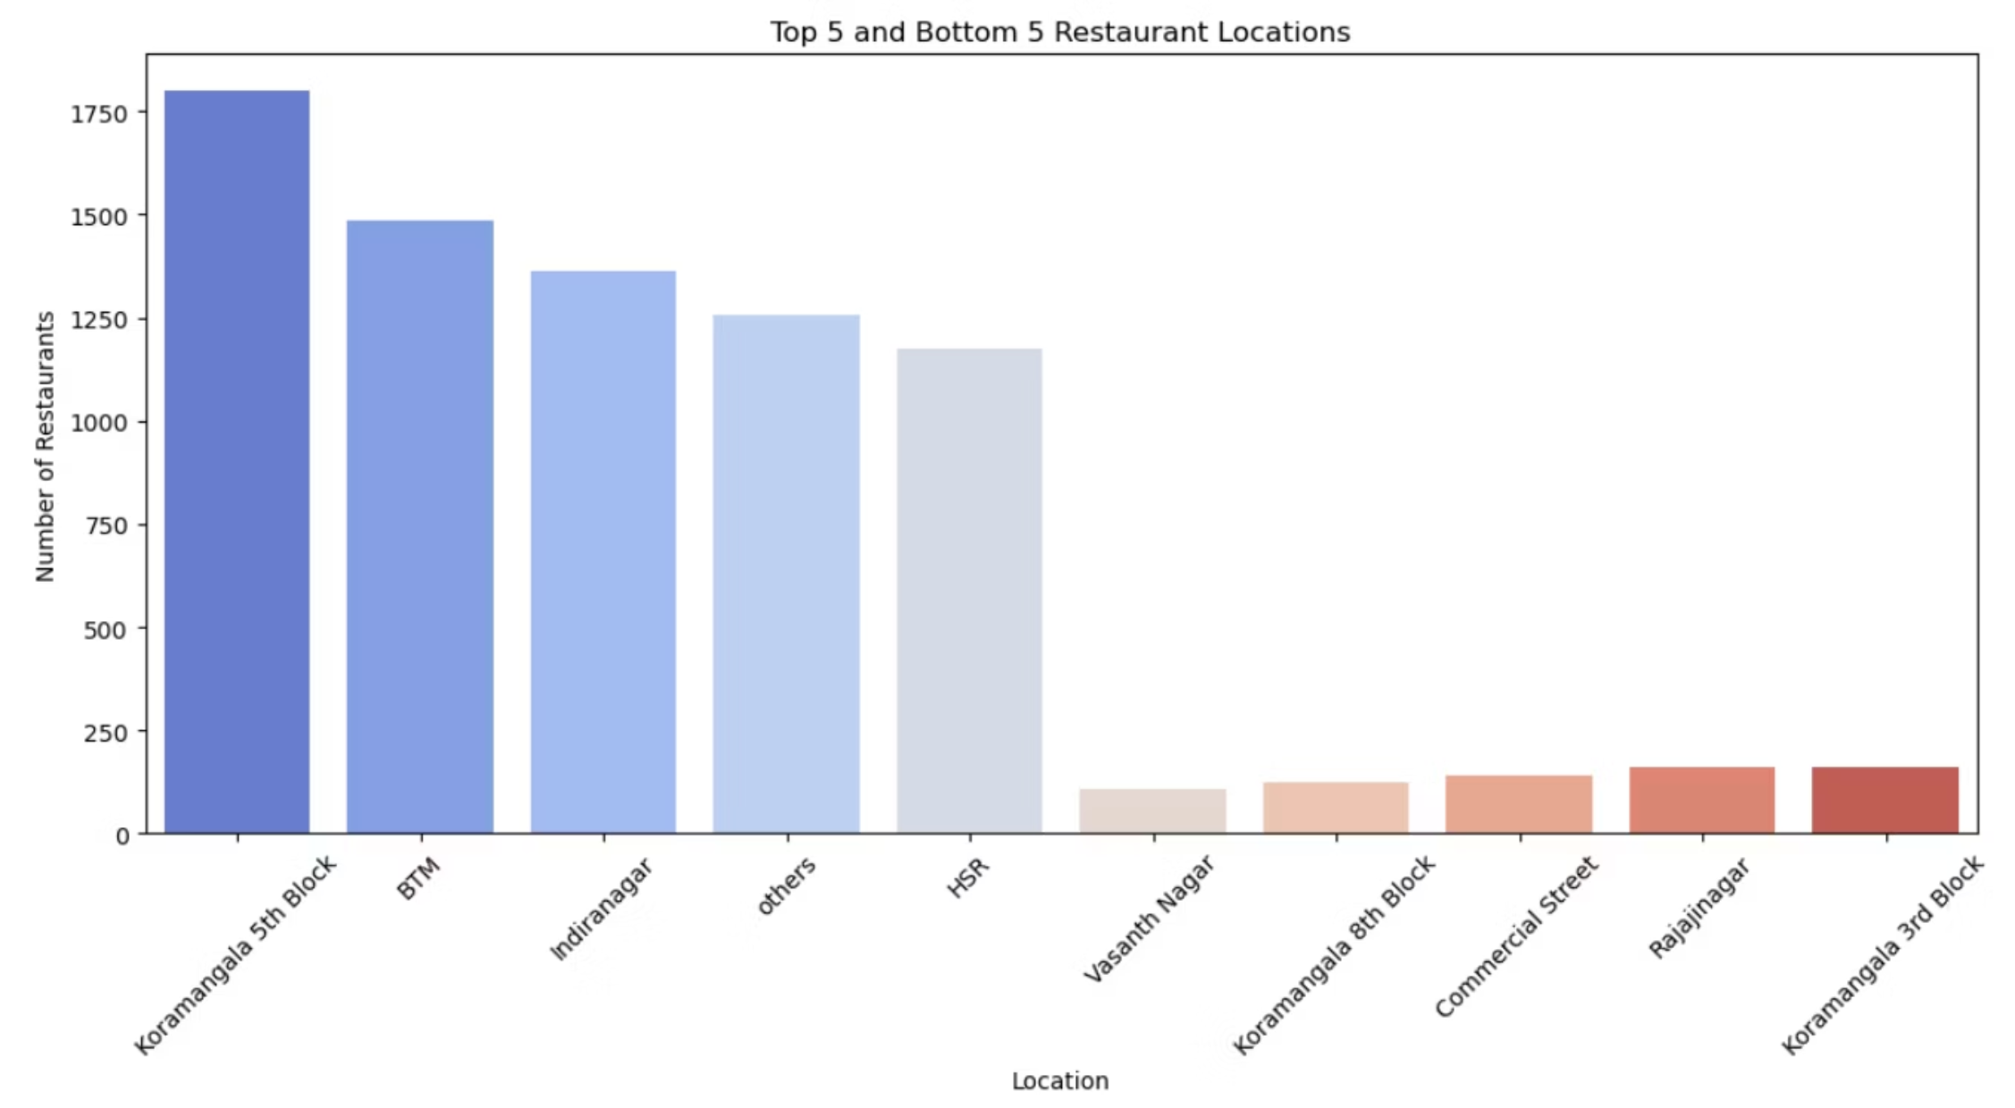
1. Geographic Distribution of Restaurants in Bengaluru
1.High concentration in popular areas – The top 5 locations (e.g., Koramangala, Indiranagar, etc.) have a significantly higher restaurant density, showing these are prime dining hubs with strong customer footfall and competition.
2.Low market presence in bottom 5 – The bottom 5 locations have minimal restaurant representation, suggesting either low demand, limited infrastructure, or untapped markets that could be explored.
3.Potential business strategy – While top 5 areas offer visibility and customer reach, the bottom 5 areas might present low-competition opportunities for niche or first-mover advantage if demand grows.

Slide 6
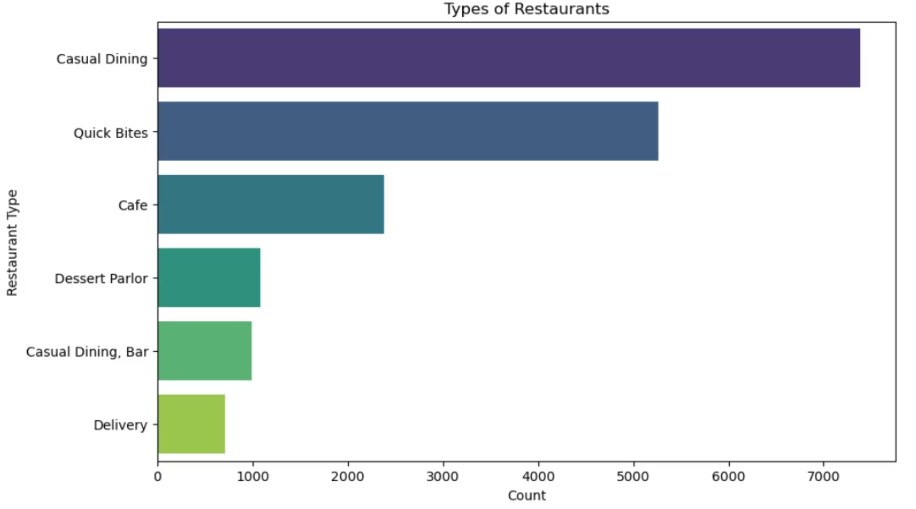
2.Various Types of Restaurant we have in Bangalore
1.Casual Dining dominates – It is the most common restaurant type by a wide margin, with around 7,400 outlets, showing strong customer preference for sit-down dining experiences.
2.Specialized formats are niche – Dessert Parlors, Casual Dining Bars, and Delivery-only outlets have relatively small market presence, each with under 1,100 outlets, catering to more specific customer needs.
3.Opening a Casual Dining or a Bar will help you earn more money as the number of these are very less in the market.

Slide 7
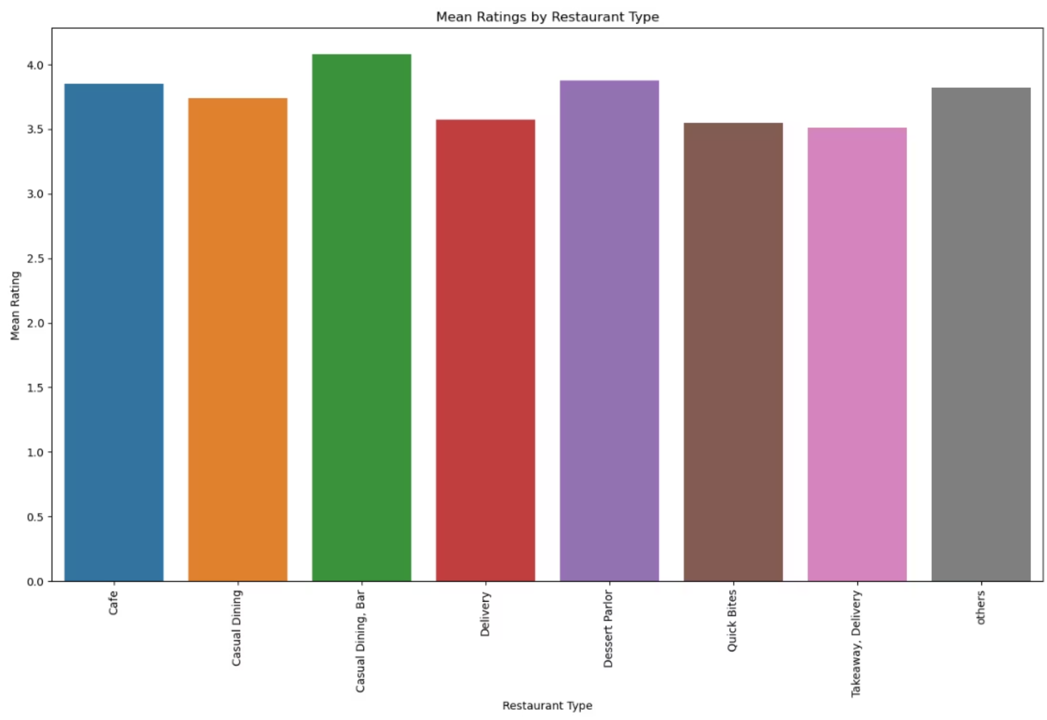
3. Average Customer Ratings Across Restaurant Types

Slide 8
Key Insights:
Casual Dining, Bar stands out as the top performer with the highest mean rating above 4.0, indicating strong customer satisfaction likely driven by ambiance, food quality, and overall experience.
Quick Bites and Takeaway, Delivery show the lowest average ratings (around 3.5–3.6), suggesting that faster service models may not fully meet customer expectations compared to dine-in setups.
Cafes, Casual Dining, and Dessert Parlors hover around the 3.8 to 3.9 mark, showing consistent performance but not as high as Casual Dining Bars.
The "others" category also performs relatively well (~3.8), indicating that even niche or unclassified restaurant types can maintain strong customer ratings.

Slide 9
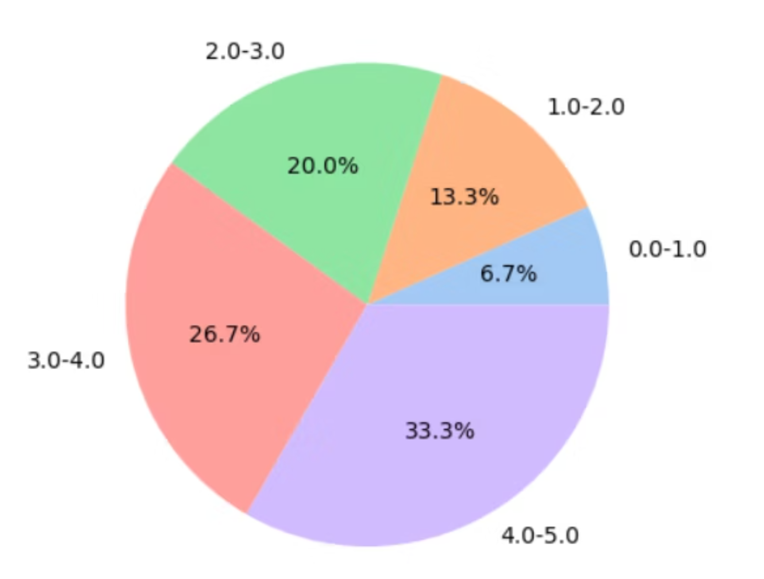
4. Customer Ratings Skewed Towards Positive Reviews in Zomato Dataset
High Satisfaction Trend:A significant 33% of customers rated restaurants between 4 to 5, indicating a strong overall customer satisfaction and positive dining experiences.
Very Few Poor Ratings:Only 6.37% of the ratings fall between 0 to 1, suggesting that extreme dissatisfaction is relatively rare among the reviewed restaurants.

Slide 10
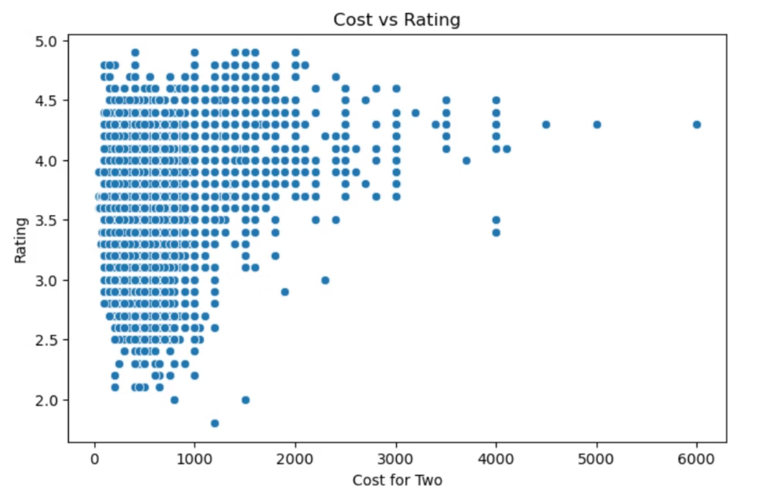
5. Cost vs Rating
High Ratings Are Not Limited to High Costs:The majority of restaurants with ratings between 4.0 to 4.5 fall within the ₹200 to ₹1000 cost range. This suggests that even affordable restaurants are receiving excellent ratings, indicating good value for money.
Expensive Restaurants Don’t Guarantee Higher Ratings:Although a few restaurants cost above ₹3000, they don’t necessarily have the highest ratings. In fact, ratings are scattered for high-cost options, implying that costlier meals don’t always lead to better customer satisfaction.

Slide 11
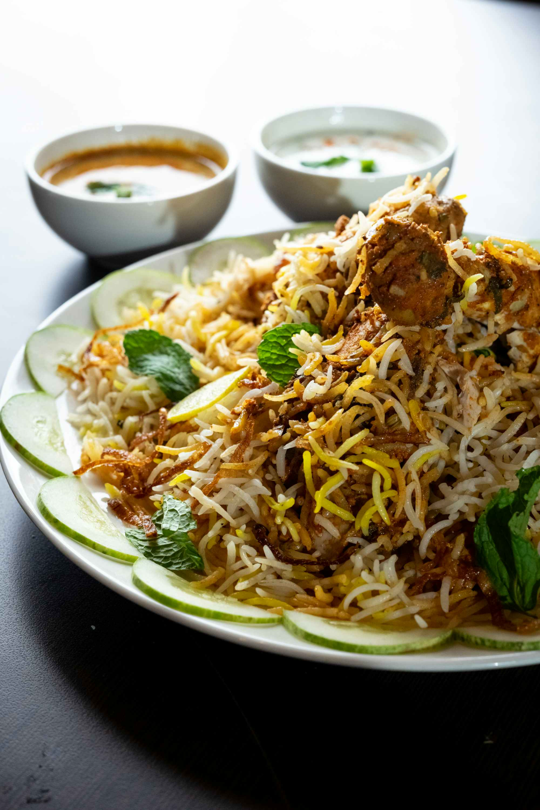
6. Analysing Cuisine and Dish Popularity
Understanding customer preferences for specific cuisines and dishes is crucial for menu planning and market positioning. Our analysis of the Zomato dataset reveals clear favourites among Bengaluru's diners.
Top Favourite Items: Biriyani leads as the most loved item, followed by Pasta, Burgers and Cocktails, indicating a strong preference for international and contemporary dishes.
Common Restaurant Offerings: Chicken Fried Rice is the most common item found across restaurants, with Veg Fried Rice and Paneer Butter Masala also highly prevalent. This highlights popular comfort food options.

Slide 12
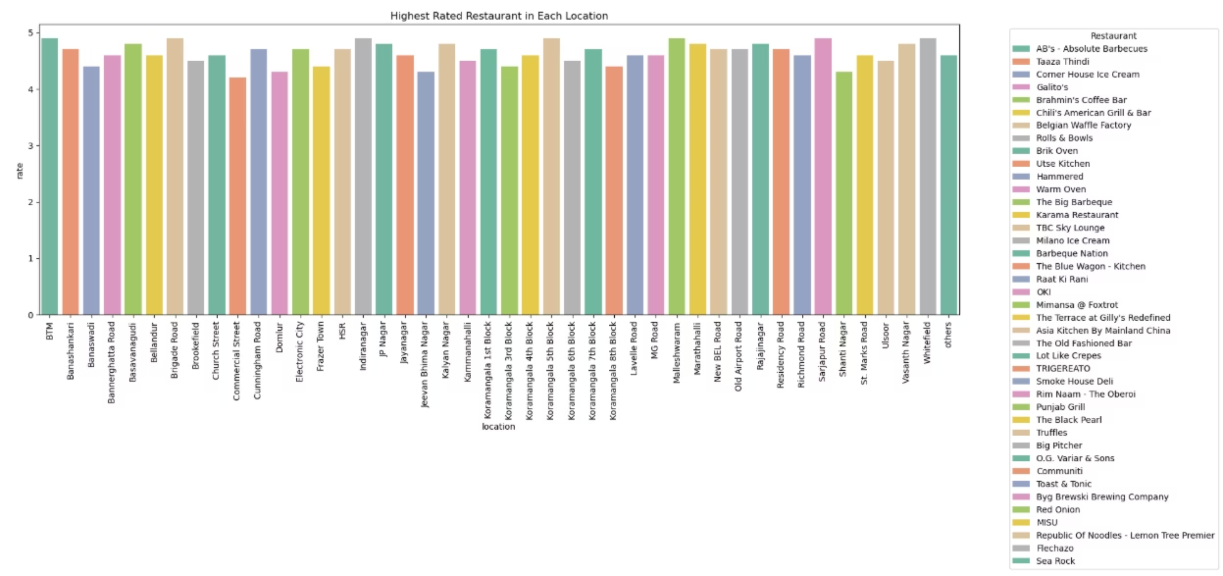
7. The Top rated restaurants from each Area

Slide 13
Key Insights:
1.High rating consistency across locations – Most highest-rated restaurants in each location score between 4.3 and 4.9, showing strong competition in quality.
2.No single restaurant dominates all locations – The top-rated spot varies widely by area, suggesting that local favorites and niche offerings are key to success in different neighborhoods.
3.Premium and specialty brands perform strongly – Many highest-rated restaurants are well-known for specific cuisines (e.g., barbeque, desserts, or coffee), indicating that specialization helps secure top ratings.

Slide 14
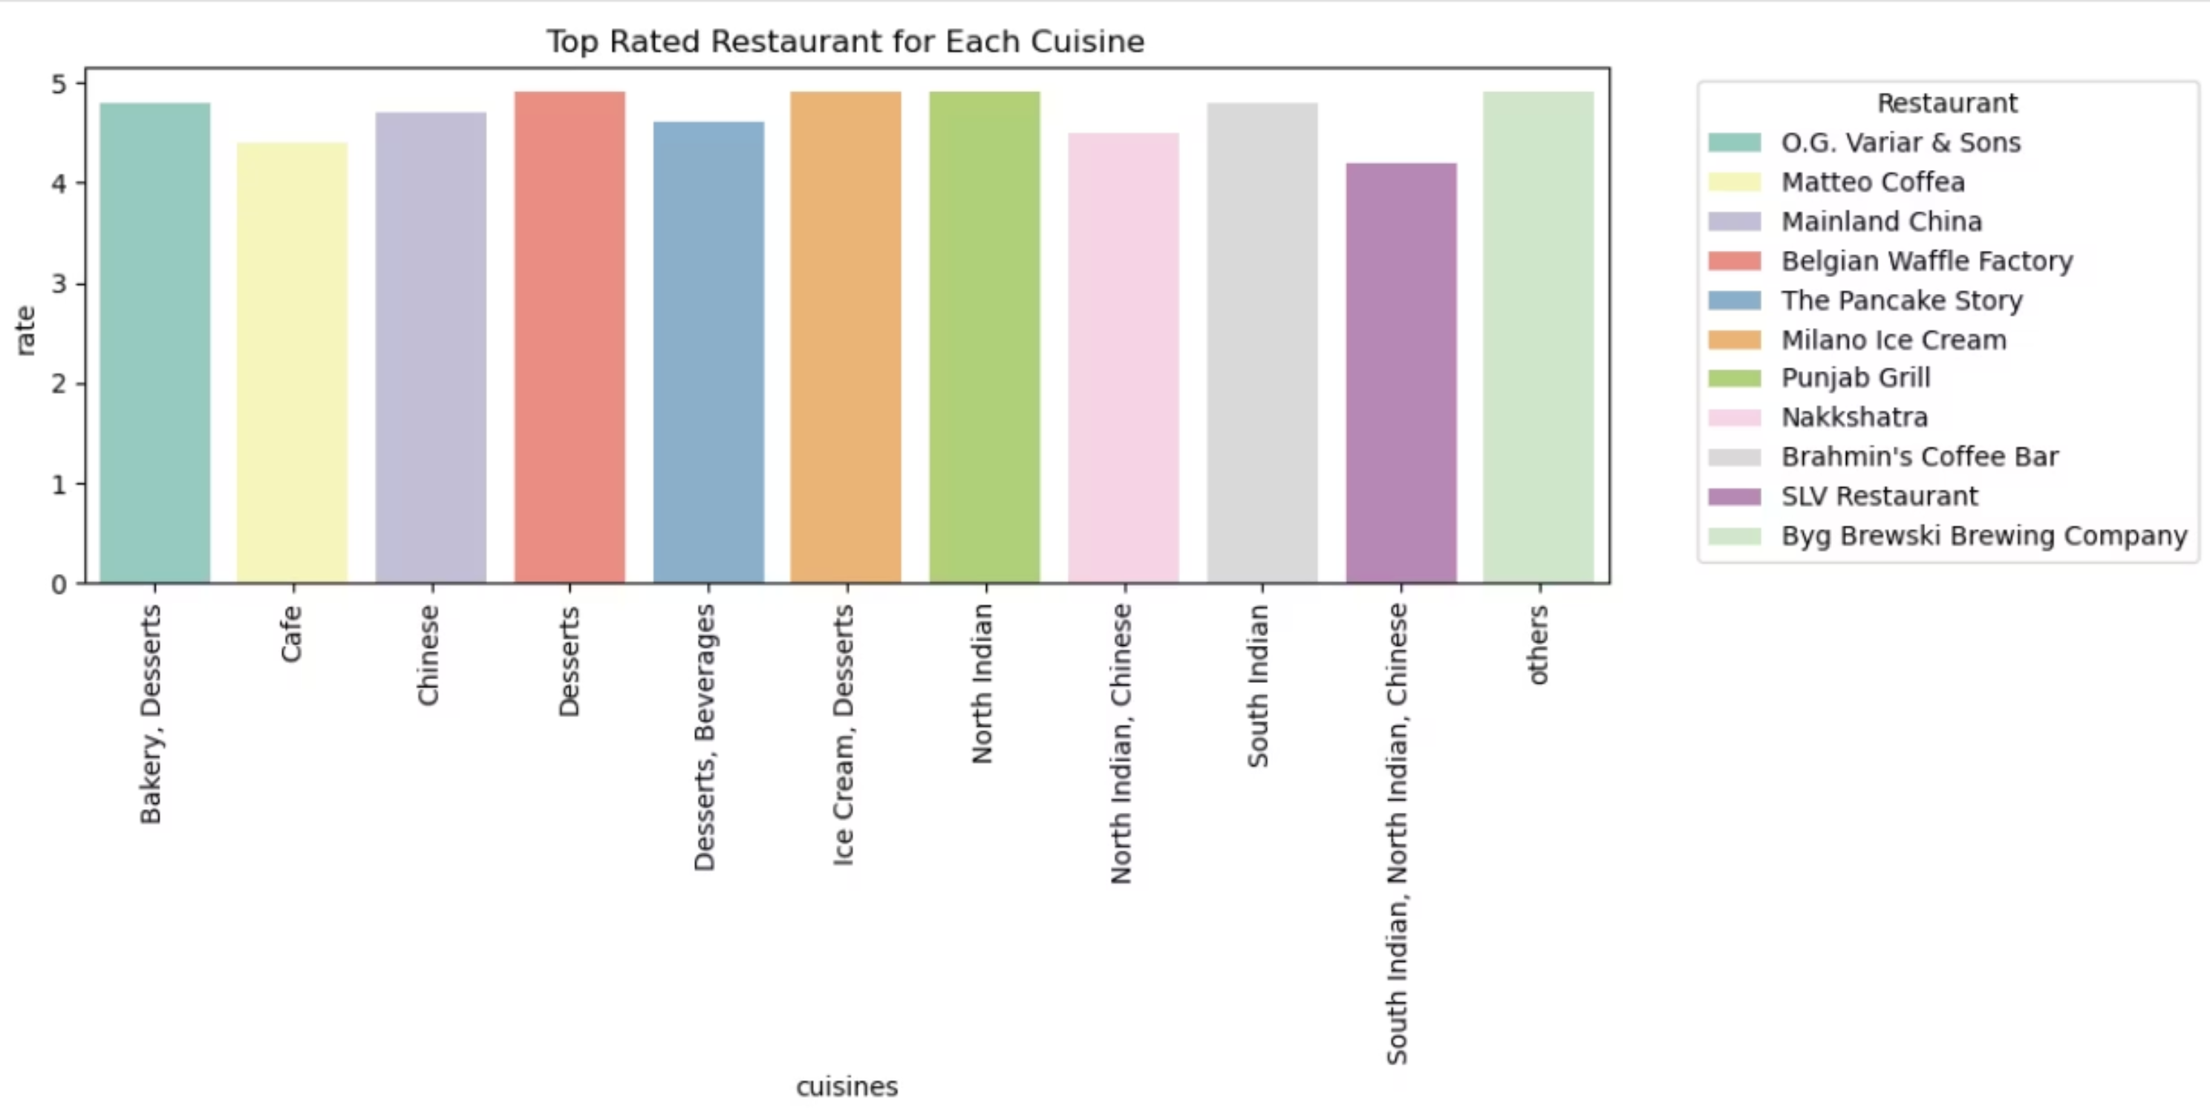
8. Best choice of the Restaurant for different Cuisine in Banagalore

Slide 15
Key Insights:
1.Dessert-focused restaurants dominate top ratings – Belgian Waffle Factory and Milano Ice Cream lead their categories with ratings close to 5, showing strong customer preference for sweet-focused cuisines.
2.North Indian cuisine holds consistently high ratings – Punjab Grill achieves nearly perfect scores, indicating high customer satisfaction for this category.
3.Cafés have relatively lower top ratings – Matteo Coffea, while leading in the Café category, has the lowest rating among top cuisine leaders, suggesting greater competition or varied customer expectations in this segment.

Slide 16
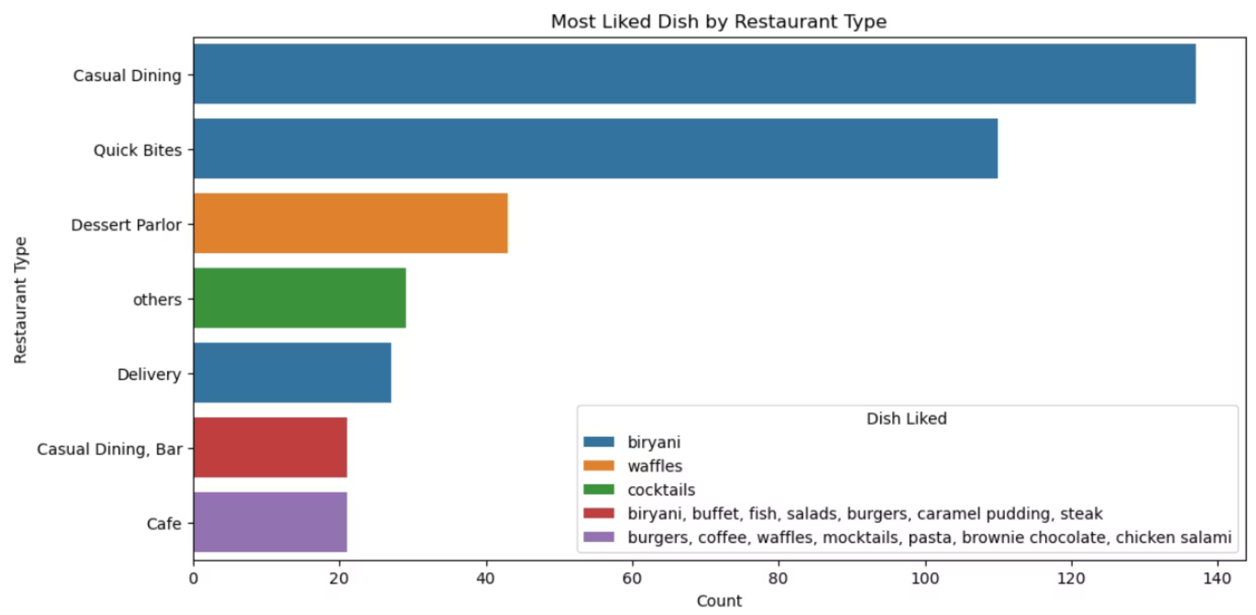
9. Most Liked Dish by Restaurant Type
1.Biryani's Dominance: Biryani is the most liked dish in both "Casual Dining" and "Quick Bites" restaurants, highlighting its widespread popularity.
2.Dessert Parlor Specialization: Dessert Parlors are specifically known for waffles.
3.Cafe Diversity: Cafes have a broad range of popular items, including burgers, coffee, and pasta.

Slide 17
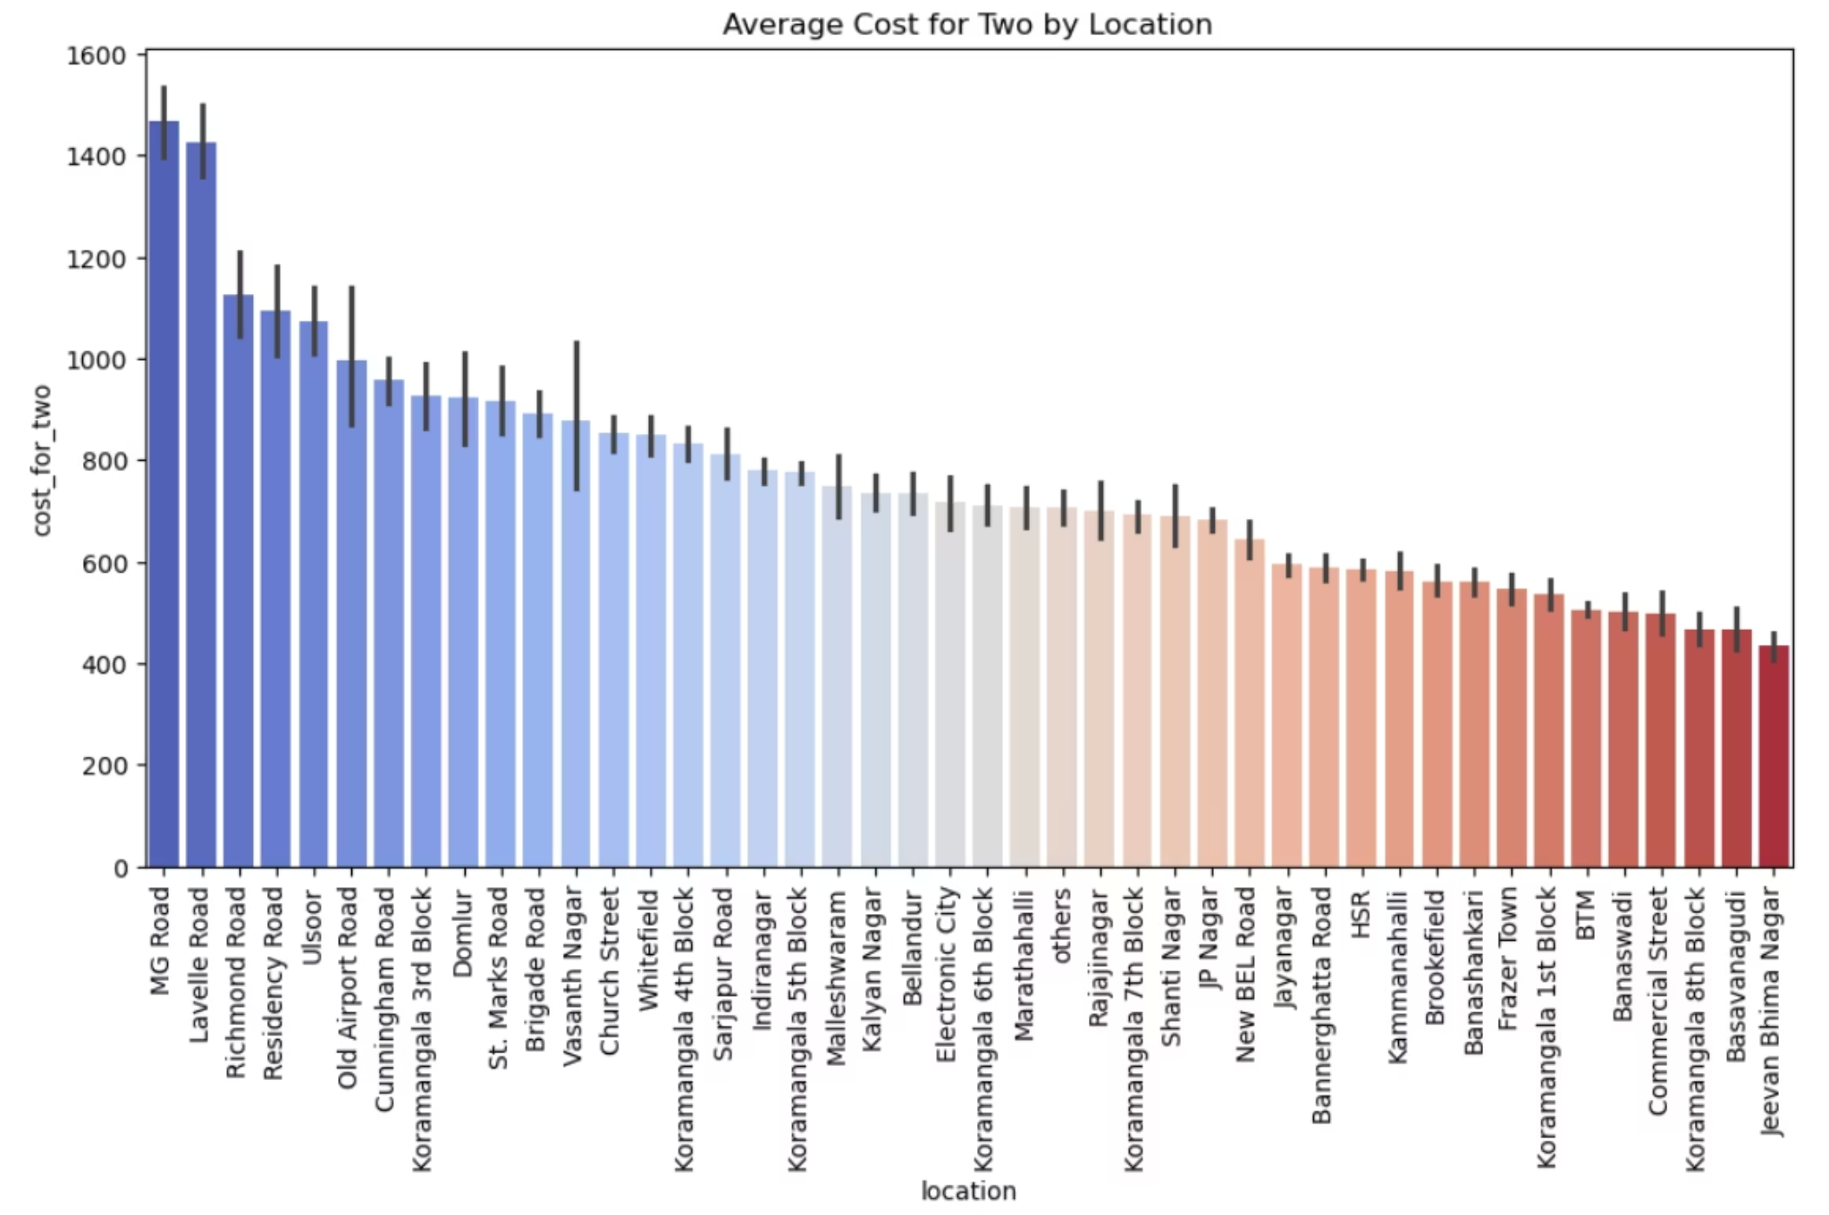
10. Location wise cost
1.High-End Areas: Locations like Brigade Road and Church Street have the highest average cost for two, exceeding ₹1400.
2.Affordable Options: Areas such as Old Airport Road and HSR are significantly more affordable, with an average cost around ₹600.
3.Koramangala's Price Variation: Within the same large neighborhood, Koramangala, there is a wide range of pricing, with some blocks (e.g., 3rd and 4th) being more expensive than others (e.g., 5th and 7th).

Slide 18
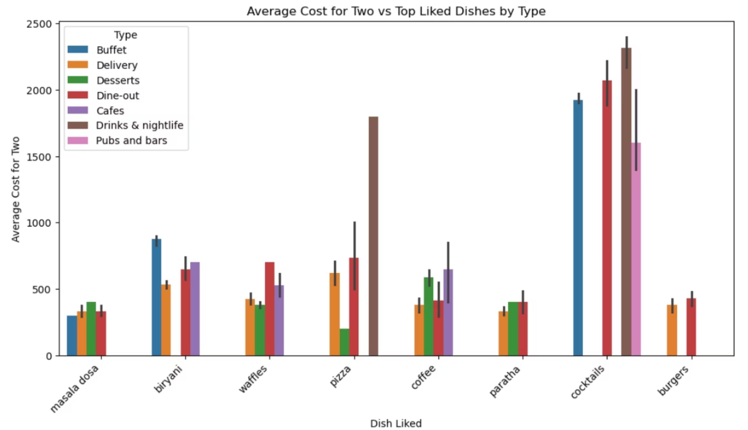
11. Dish liked with type and cost_for_two
1.Casual Dining leads significantly – It’s the top restaurant type without online ordering or table booking, exceeding 7,000 listings.
2.Quick Bites is the second most common – With over 5,000 outlets, it shows strong offline presence.
3.Delivery and Dessert Parlors are rare – Both have low counts (under 1,200), meaning most in these categories rely on online orders or reservations.

Slide 19
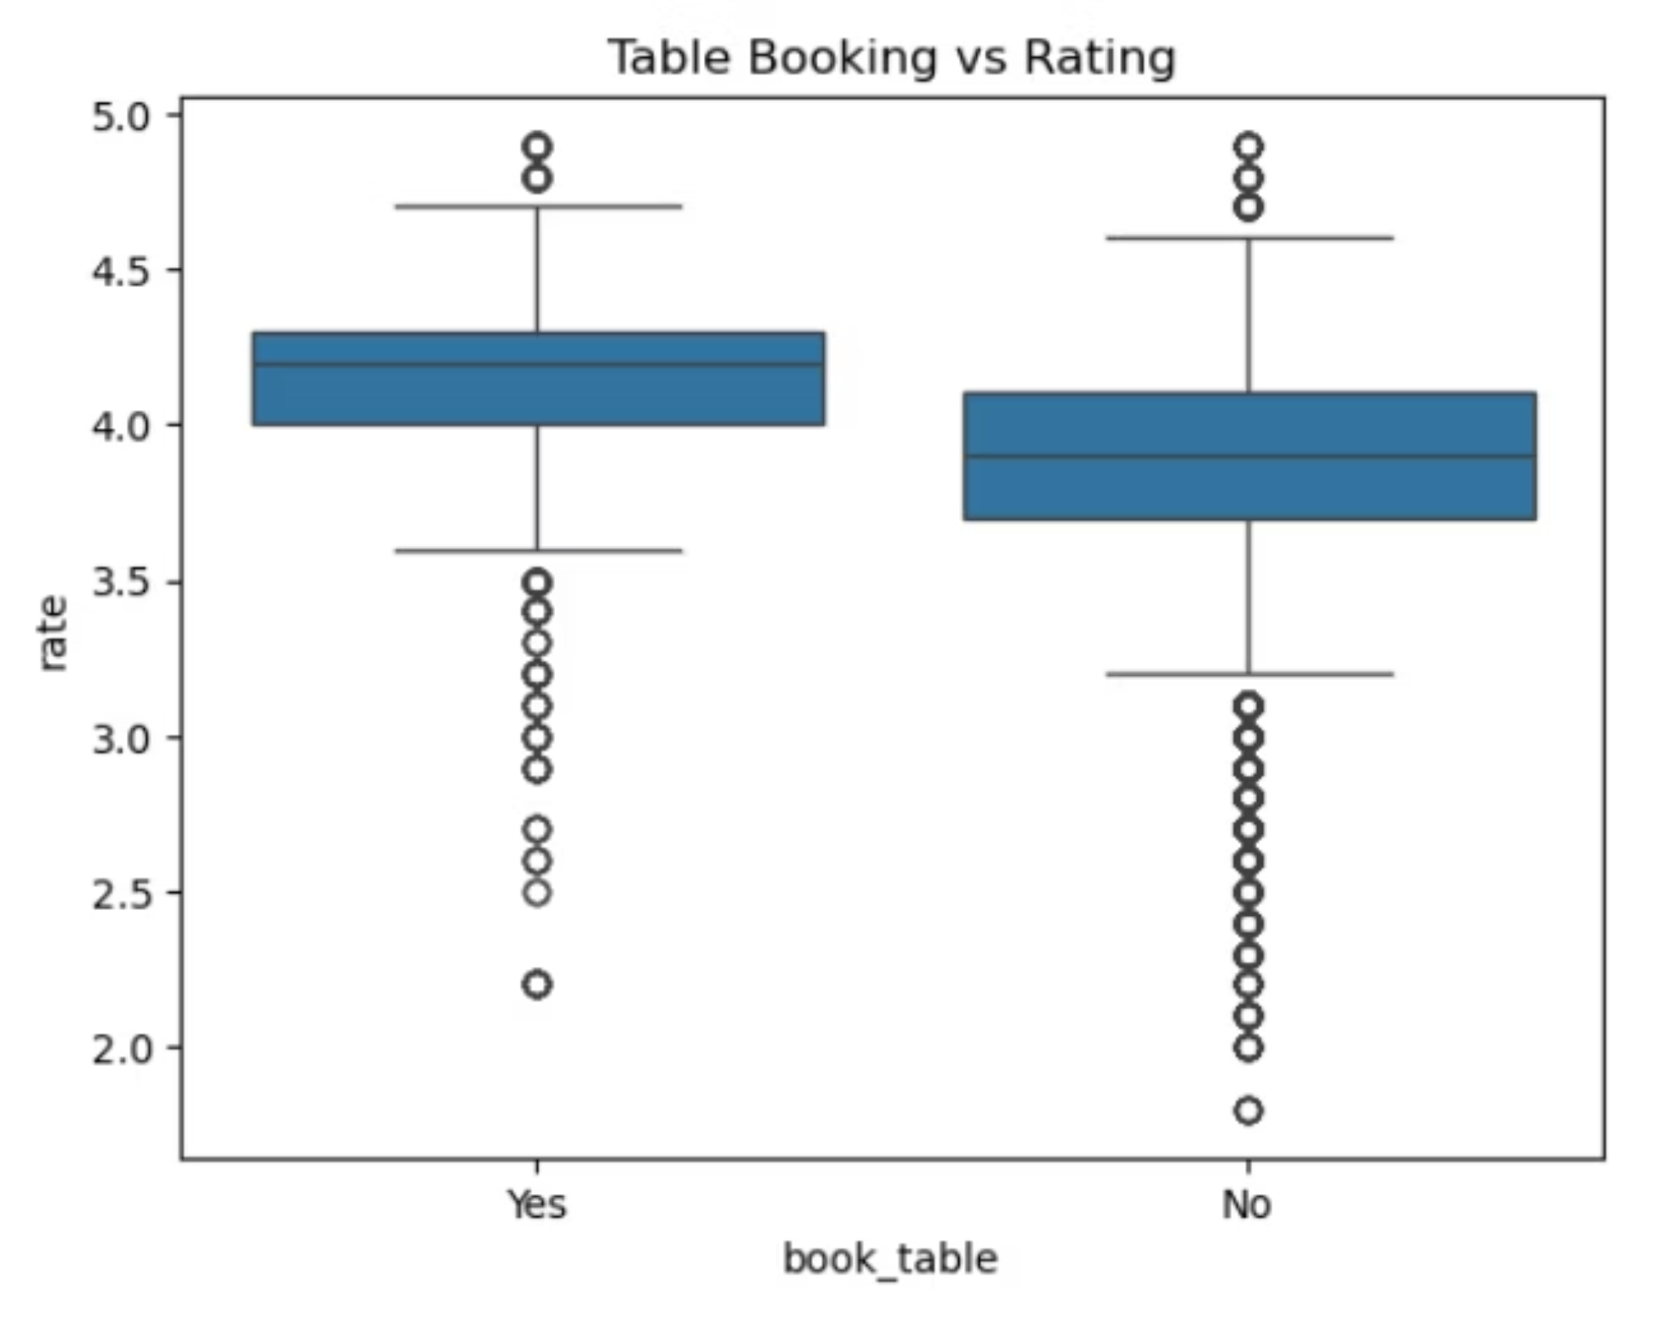
12. Do restaurants with table booking have better ratings?
Higher Median Rating for Table Bookings: The median rating is higher for restaurants that accept table bookings ("Yes") than for those that don't ("No").
More Consistent Ratings Without Table Bookings: The ratings are more tightly clustered (smaller box) for restaurants without table bookings, indicating less variability in the middle 50% of ratings.
Similar Low-End Ratings: Both groups have outliers with similarly low ratings, suggesting that even with table booking, some restaurants perform poorly.

Slide 20
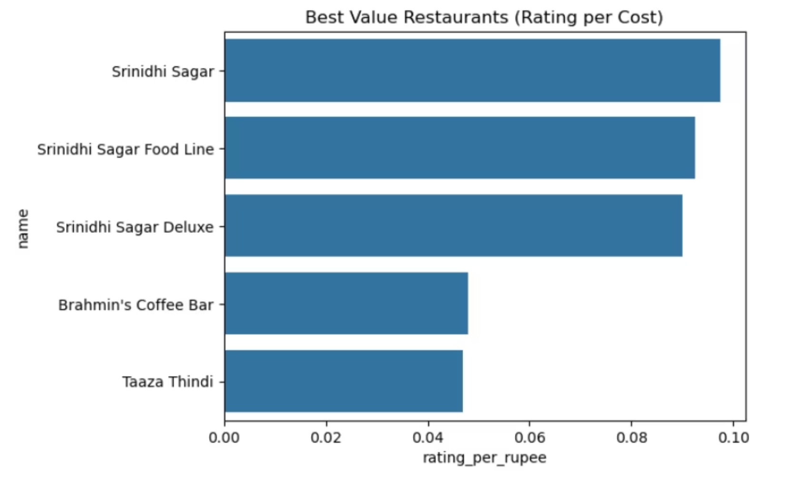
13. Which restaurant has the best rating per rupee spent?
Srinidhi Sagar Restaurants are Top Performers: The three Srinidhi Sagar restaurants—Srinidhi Sagar, Srinidhi Sagar Food Line, and Srinidhi Sagar Deluxe—have the highest "rating_per_rupee" values, indicating they offer the best value among the restaurants shown.
Significant Value Gap: There is a large gap in value between the top three restaurants and the bottom two. The value scores for Brahmin's Coffee Bar and Taaza Thindi are less than half of the scores for the Srinidhi Sagar restaurants.
Similar Value for Bottom Two: Brahmin's Coffee Bar and Taaza Thindi offer nearly identical value, with their bars being of similar length. This suggests they provide a comparable return in terms of rating for every rupee spent.

Slide 21
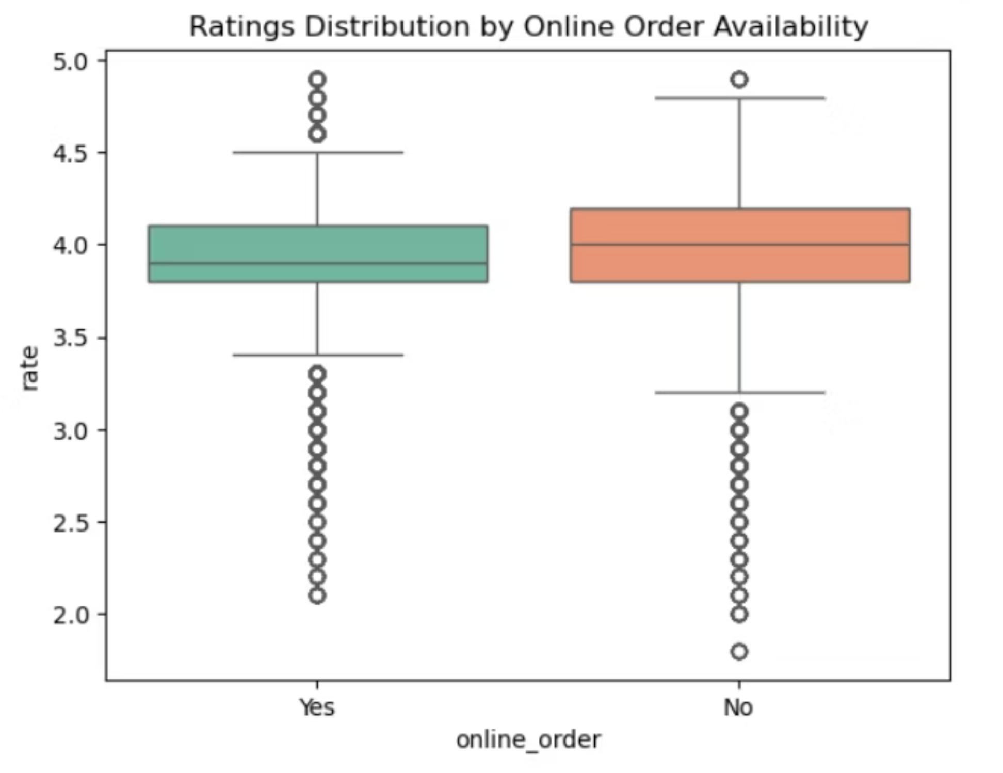
14. Are higher-rated restaurants more likely to accept online orders?
Slightly Higher Median for No Online Orders: Restaurants without online ordering have a marginally higher median rating.
More Variable Ratings with Online Ordering: The ratings for restaurants with online ordering are more spread out, showing greater variability.
Similar Range of Extremes: Both groups have a similar range of very high and very low ratings.

Slide 22
Impact of Online Ordering and Table Booking on Ratings
Providing convenience features significantly influences customer satisfaction and, consequently, restaurant ratings.
Online Ordering
Table Booking
Restaurants offering online ordering services achieve an average rating of 3.7. This indicates that the convenience of ordering from home positively impacts customer perception and overall satisfaction.
Establishments with table booking facilities command an even higher average rating of 4.1. This suggests that guaranteed seating and reduced wait times are highly valued by diners, leading to superior experiences.
Moreover, a significant portion of restaurants do not provide booking facilities, particularly in high-density areas like BTM. Koramangala 5th Block, however, shows a comparatively higher percentage of restaurants with table booking options.

Slide 23
Key Takeaways for Restaurant Success
Prioritise Online Presence & Booking
Strategic Location Selection
Restaurants offering online ordering and table booking consistently receive higher ratings, underscoring the importance of digital convenience in enhancing customer experience.
While high-density areas like BTM have many restaurants, consider less saturated localities like Old Airport Road or St. Marks Road for new ventures to reduce immediate competition.
Curate Popular Menus
Focus on Customer Satisfaction
Aligning menu offerings with popular items like Pasta, Burgers, and Fried Rice can attract a wider customer base and cater to established tastes.
The high percentage of 4-5 star ratings suggests that delivering exceptional service and quality directly translates to positive reviews and sustained business growth.

